Slide 1



Get current - Stay current on the latest version of Windows Server

Slide 2




GET-EXPERTS
Mikael Nystrom
Mattias Lehmus
@mikael_nystrom
@1Lehmus
Mikael.nystrom@truesec.com
Mattias.Lehmus@truesec.com
MVP – 15 Years
Automation Expert
Likes Food, mostly
Seafood, ish
Notes:
MN ML

Slide 3
Upgrading is easy
You just need to know how…
Notes:
MN

Slide 4
But, there is a BIG but…
Notes:
MN

Slide 5
Core Components
New Server OS
Validated in your environment
Deployment Solution
Patch Management
Monitor solution
Backup solution
Else…
You will waste to much time, time you don’t have…
It needs to be ready for production before you begin
Notes:
MN

Slide 6
DEMO SLIDE
Notes:
MN

Slide 7
Upgrading is easy
Most tools are free and fairly easy
Server Migration Tools, File Server Migration, MAPS, Scripts
There are lots of how-to and guide lines
Remote Desktop Services
Web Server (IIS)
Windows Server Update Services
MultiPoint Services
You are NOT the first (or “special”)
You are more likely to be the last…
Notes:
ML

Slide 8
Guides…
https://docs.microsoft.com/en-us/windows-server/get-started/migrate-roles-and-features
Notes:
ML

Slide 9
DEMO SLIDE
Notes:
ML

Slide 10
50%
Of all Windows Servers are unsupported
Notes:
MN

Slide 11
Running unsupported
Mainstream and Extended Support
Mainstream is for everyone
Extended support is separate agreement (very uncommon)
What is the issue, really?
Weakest link
Unable to upgrade other systems
Security limitations
Notes:
MN

Slide 12
So, what do I have?
Notes:
MN

Slide 13
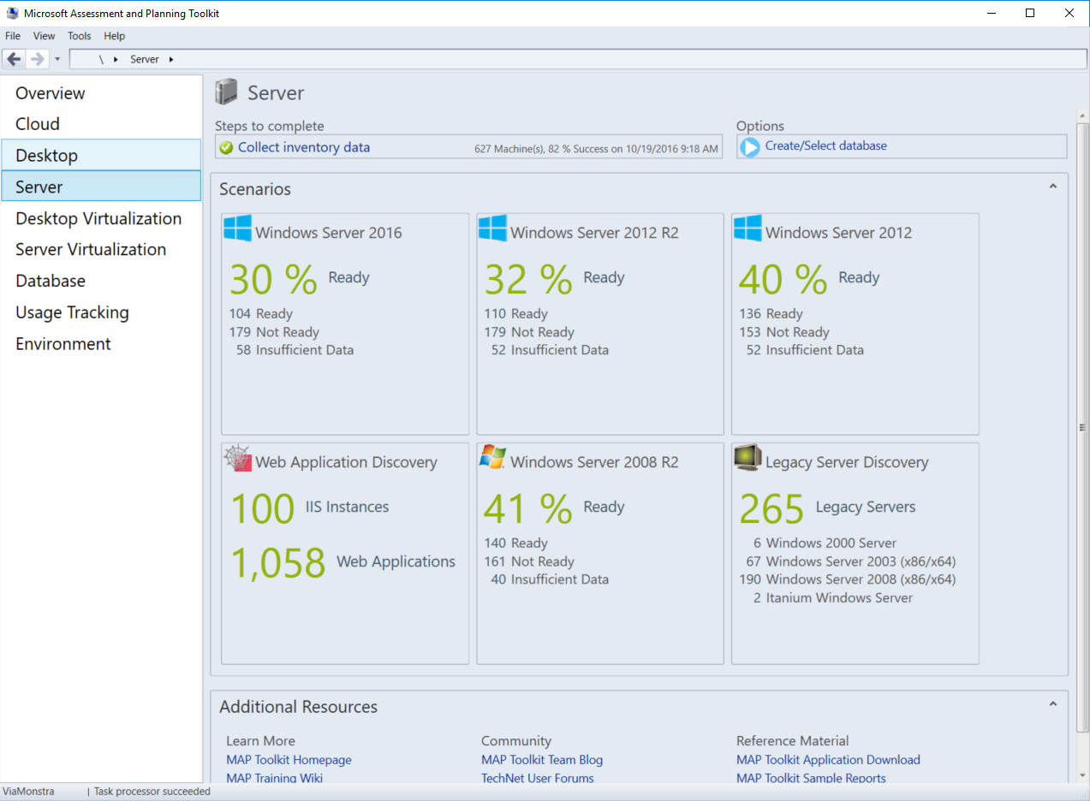
You need to know what you have
Notes:
MN

Slide 14
DEMO
Notes:
MN

Slide 15

What are my options?
Notes:
ML

Slide 16
Realistic Options
Decommission
If you don’t need it, well, you don’t need it
Transform
Migrate to other system, Merge, Azure, combine..
Side By Side
Deploy new OS, Copy data, verify, switch
Bonus: It verifies your DR solution
In place Upgrade
Upgrade existing OS with applications
Last resort, don’t do this, it sucks
Notes:
ML

Slide 17
Getting dirty, time to work
Notes:
ML

Slide 18
Migrate File servers
Disconnect – Connect
Fully supported, dump Share from registry
File server Migration tool
Deluxe Robocopy
Azure File Services
Transforming to the cloud
Azure File Sync
Almost transforming to the cloud
StorSimple, but no hardware and works
Notes:
MN

Slide 19
DEMO SLIDE
Notes:
MN

Slide 20
Migrate Print Servers
Print Server Cluster
Does not exist anymore, use LB’s
Export – Import
Printer Migration Wizard
Printbrm.exe
Hybrid Cloud Print
Works for AAD joined devices
Use on-premisses Print Server
Notes:
ML

Slide 21
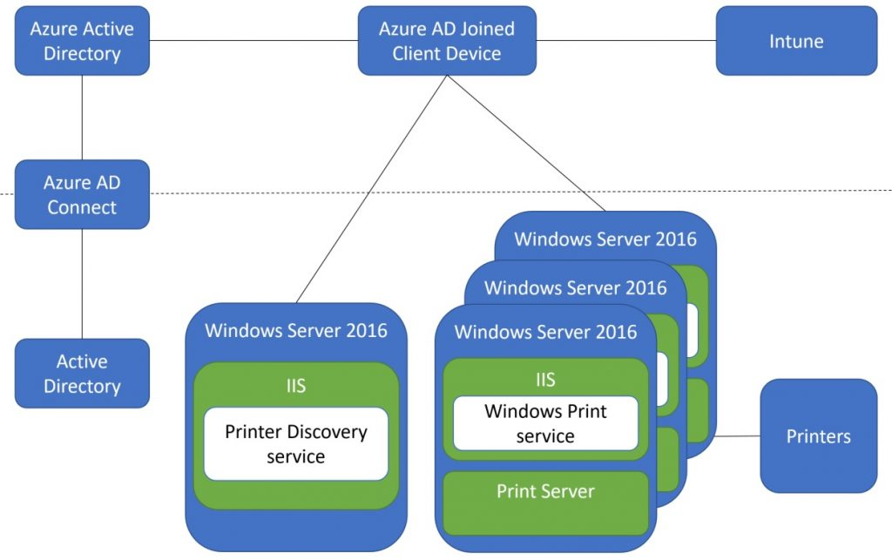
Hybrid Cloud Print
Notes:
ML

Slide 22
DEMO SLIDE
Notes:
ML

Slide 23
Active Directory - Side-By-Side
Verify replication and general health
Get IP, Name from DC01
Rename and change name on DC01
Install new DC01, with old IP
Install ADDS, Inc DNS
DC Promo
Verify replication and general health
Repeat for all other DC’s
Verify replication and general health
Wait for a few days
Decommission old DCs
Verify replication and general health
Cleanup in Sites and Services/AD/DNS
Notes:
MN

Slide 24
DEMO SLIDE
Notes:
MN

Slide 25
SQL
Upgrade – In place (OS/SQL)
Works from 2005 and up
Upgrade – Side by Side (OS/SQL)
Works from 2005 and up
Transform to Azure
Works from 2005 and up
Notes:
ML

Slide 26
DEMO SLIDE
Notes:
ML

Slide 27
What About The Web?
Sure it are being used?
Still sure?
Really sure?
WebDeploy or Azure App Service Migration
WebDeploy supports IIS 6.0 (code name "Duct Tape") and

Slide 28
DEMO SLIDE
Notes:
ML

